Slide 1

Fraud Detection For Banking
Sample Guys

Slide 2




The Team
Maitha Alshaali
Information Security Analyst
Nafitha Najeeb
Finance Specialist
Hergen Meyer
Product Development Director
Dominique Duclayan
Profession

Slide 3

Machine Learning Fraud Detection
Statistical Models
Trillions of dollars in loss

Slide 4
Problem Definition:
In this project, we are detecting fraudulent transactions from the Banksim dataset.
The Data Science Project we have selected deals with detecting fraudulent transactions and applying Machine Learning Model.
The source of the data is: https://www.kaggle.com/turkayavci/fraud-detection-on-bank-payments
The dataset consists of payments from various customers made in different time periods and with different amounts.

Slide 5
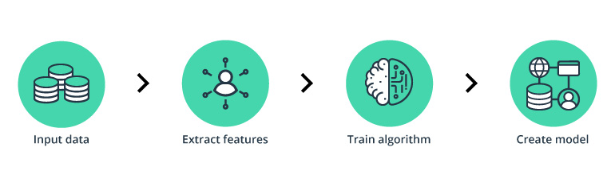

Slide 6
2. Exploratory Data Analysis
Notes:
No missing data. From two large datasets.

Slide 7
The Dataset
The Dataset has 9 feature columns and a target column.
Feature Descriptions:
Step: This feature represents the day from the start of simulation. It has 180 steps so simulation ran for virtually 6 months.
Customer: This feature represents the customer id
zipCodeOrigin: The zip code of origin/source.
Merchant: The merchant's id
zipMerchant: The merchant's zip code

Slide 8
6. Age: Categorized age
0: <= 18,
1: 19-25,
2: 26-35,
3: 36-45,
4: 46:55,
5: 56:65,
6: > 65
U: Unknown
7. Gender: Gender for customer
E : Enterprise,
F: Female,
M: Male,
U: Unknown
8. Category: Category of the purchase.
9. Amount: Amount of the purchase
Fraud: Target variable which shows if the transaction fraudulent(1) or benign(0)

Slide 9
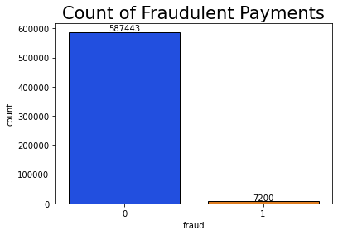
About 1.2%

Slide 10
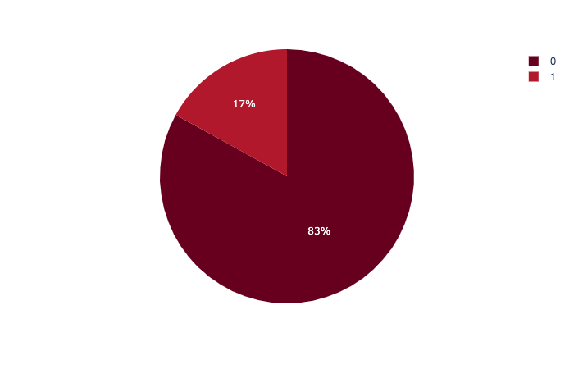
Amount of Fraudulent and Non-Fraudulent Payments

Slide 11
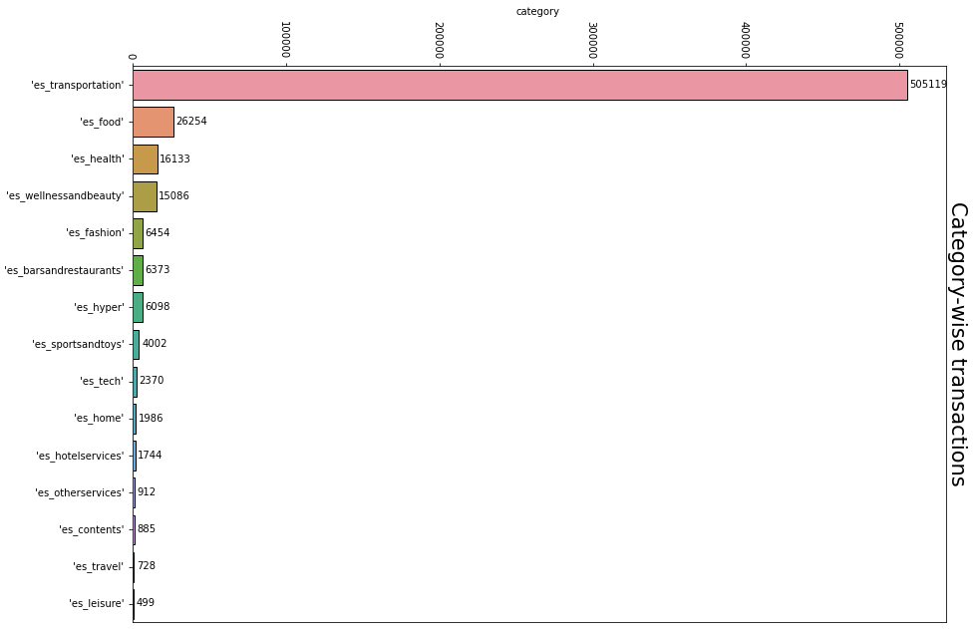
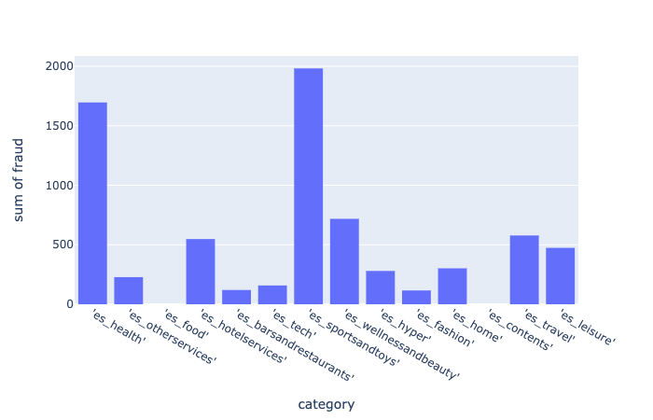
The two largest categories (es_transportation and es_food) have absolutely no fraud.

Slide 12
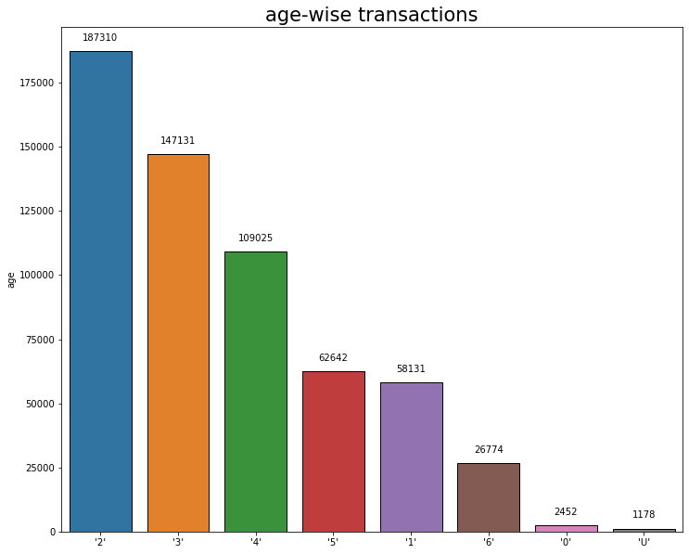
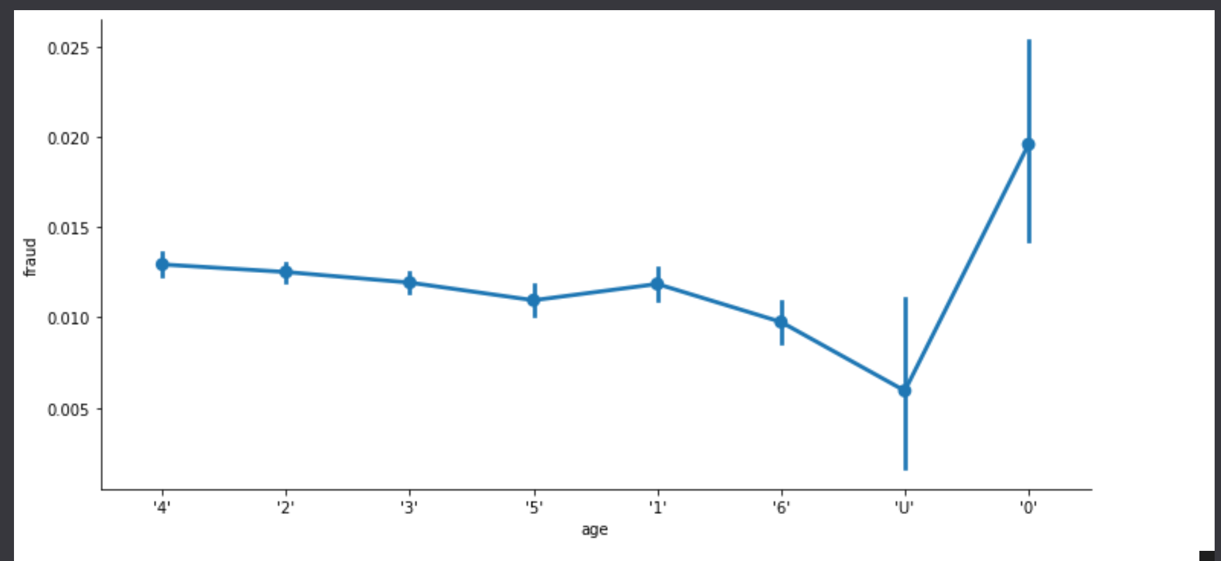
Categorized Age
0: <= 18,
1: 19-25,
2: 26-35,
3: 36-45,
4: 46:55,
5: 56:65,
6: > 65
U: Unknown

Slide 13
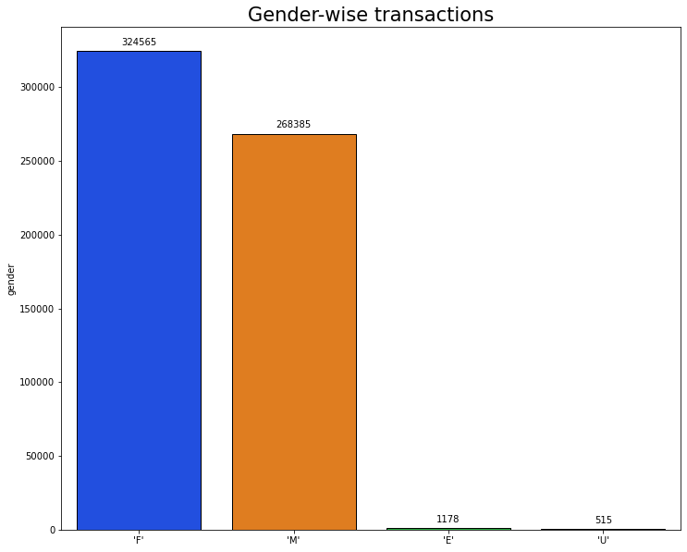
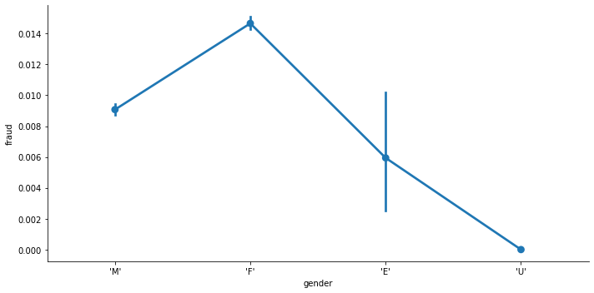
Gender for customers:
E : Enterprise,
F: Female,
M: Male,
U: Unknown

Slide 14
Initial Attempt
Irrelevant features were dropped:
'zipMerchant' - same value for all entries
'zipcodeOri' - same value for all entries
Categorical Features were dropped:
'Customer'
'age'
'gender'
'Merchant'
‘Step’
‘Categories’ => one hot encoding
=> no relevant capability to predict

Slide 15
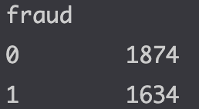
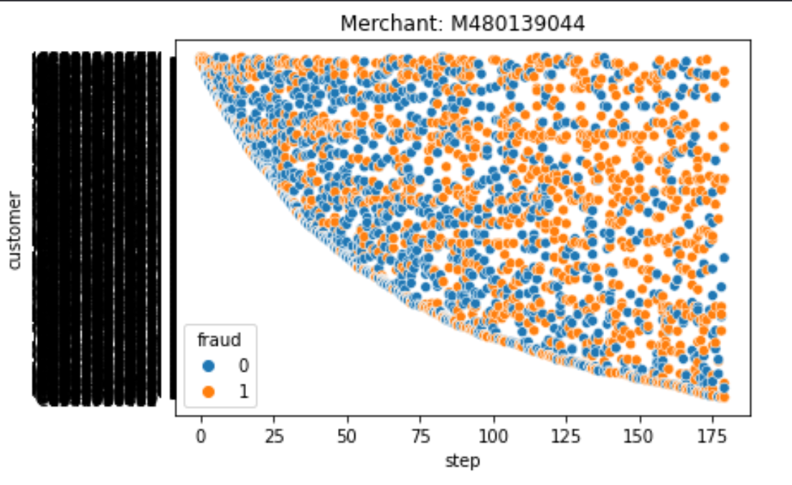
Worst Merchant:
1324

Slide 16
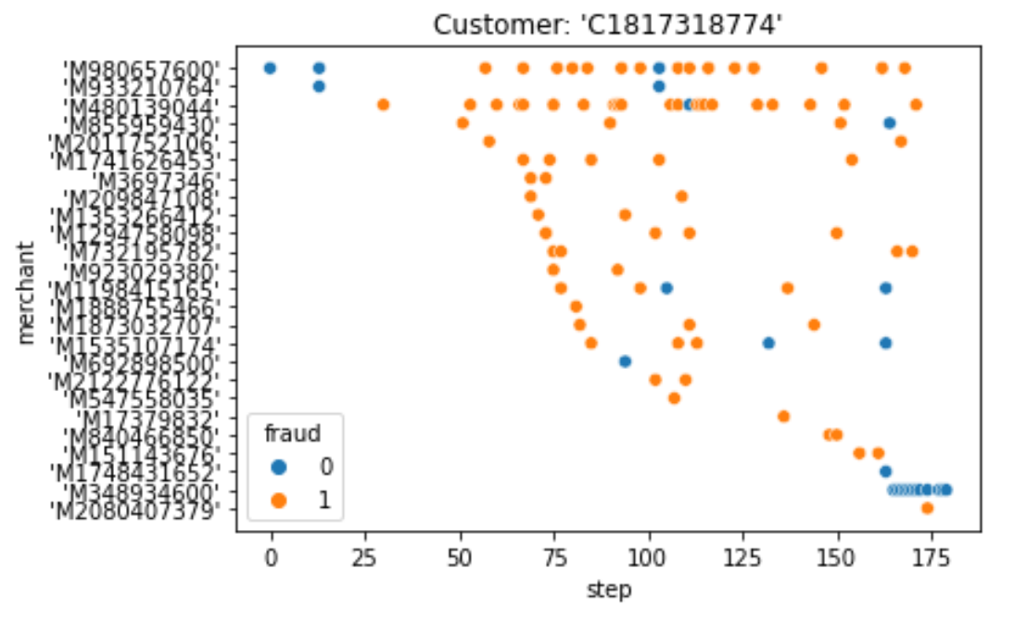
One badly hit customer

Slide 17
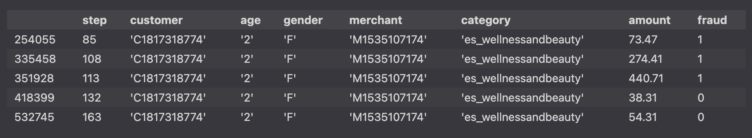
Ambiguous Customer Merchant Relationship

Slide 18
EDA - Data Engineering
Irrelevant features were dropped:
'zipMerchant' - same value for all entries
'zipcodeOri' - same value for all entries
Categorical Features were converted into numerical features:
'Customer'
'age'
'gender'
'merchant'

Slide 19
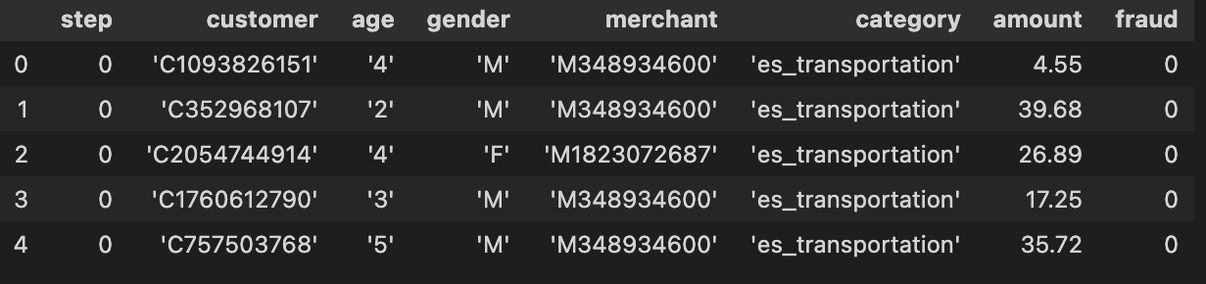
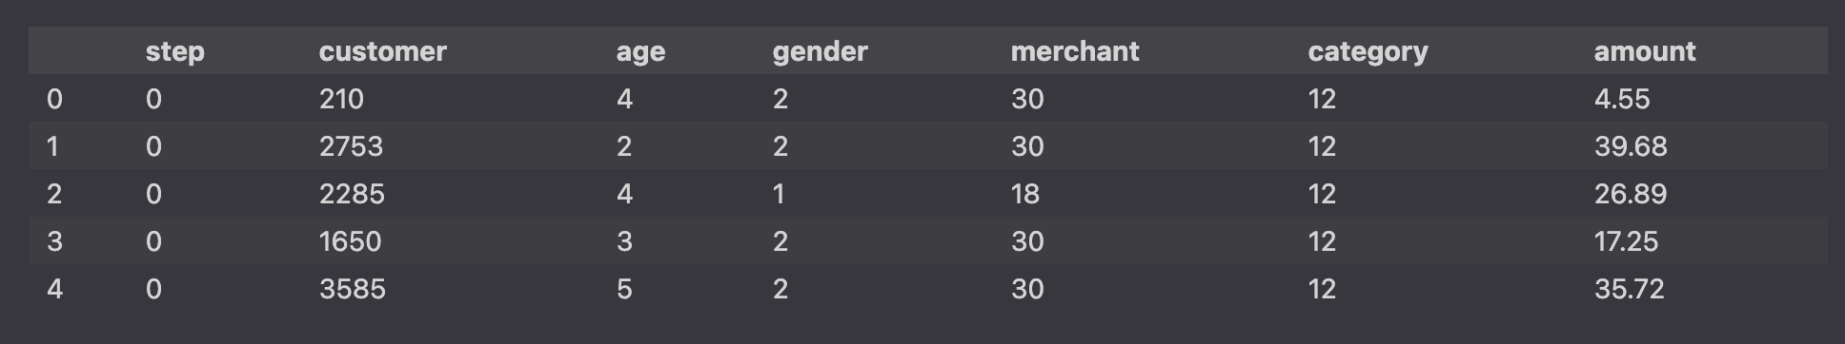
Data before EDA and Data Engineering
Data ready for Machine Learning after EDA and Data Engineering
Notes:
Slides for stages 1 and 2 upto EDA and Data Engineering done.

Slide 20
3. The Machine Learning Model

Slide 21
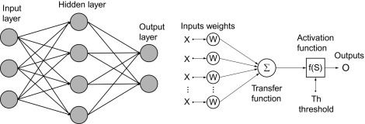
Tried and tested with Neural Network Model from Deep Learning
Total Test Cases: 237858
Predicted Fraud: 2344
Actual Fraud: 1834
Wrong Detection: 510
Missed Detection: 961
Our model was able to predict 78% of fraud
with 27% false positive
And 52% false negative

Slide 22
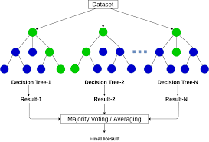
We chose “Random Forest Classifier”
Reason: Proven concept to determine binary classes (e.g. “Titanic Dataframe”)

Slide 23
4. Machine Learning Analysis

Slide 24
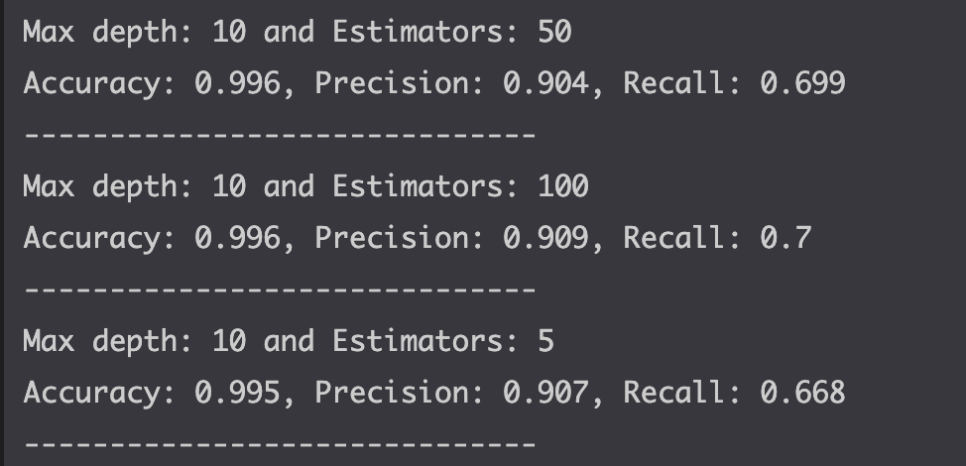
4. Machine Learning Analysis
Hyperparameters used: 'n_estimators': [5, 50, 100], 'max_depth': [2, 10, ]
Potential for improvement => 'max_depth': 20, None
60:20:20 split
We chose the best-of-3 model from the validation dataset

Slide 25
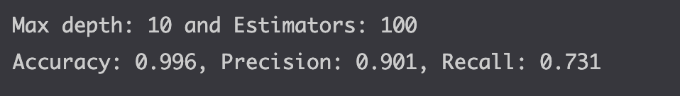
4. Machine Learning Analysis
And ran it on the test dataset:

Slide 26
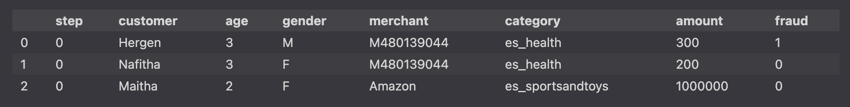
4. Machine Learning Analysis
Then we ran some fabricated datasets like:
It yielded
good results for known customer-merchant combinations
acceptable results for new customer
questionable results when both customer and merchant are new.

Slide 27
5. Conclusion

Slide 28
Conclusion 1
The suitability and aptness of the Machine Learning Model depends upon the data and the features in it.
Predicting fraud requires complex analysis of time related data

Slide 29
Conclusion 2
The top 3 challenges:
Identifying a suitable ML model
Deciding on valid features
Detection Capability vs Accuracy
Useability in real life scenarios
The top 3 lessons
Listening to a few hours of ML narratives does not make you catch thieves
Subject matter expertise could have helped us
Becoming a useful data analyst is a long road
Next steps for your data science career
Learn more - get better

Slide 30
6. Any Questions from Audience?

Slide 31
3. The Machine Learning Model
In this section, you will go over the following:
Neural Networks Model which comes under Deep Learning
The features of the model are amount of the transactions and the categories which different transaction fall into and label for the model is to predict which is fraud or not.
The reason you chose this ML model
How this model compares to other ML models
* For example: regression, classification, or clustering.

Slide 32
2. Exploratory Data Analysis
We started with analysing our dataset and found that there was no missing data. We checked the details of the fraud transactions and the correlation with different features like age, gender etc.
Age wise analysis showed that, the number of transaction and the number of fraud transactions were more in age group 2 that is 26-35.
Gender wise analysis revealed that the number of transactions were more in female category, E and U category being negligible
The two largest categories (es_transportation and es_food) have absolutely no fraud. Another pattern emerged was higher amount transactions has higher possibility of fraud.

